Slide 1
、
Harnessing Large Language Models for Knowledge Graph Question Answering via Adaptive Multi-Aspect Retrieval-Augmentation
（AAAI-2025)
code：https://github.com/Applied-Machine-Learning-Lab/AMAR
Reported by Jiale Shen

Slide 2
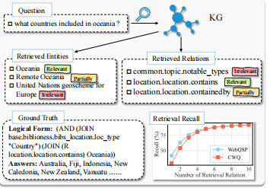
motivation
1.Large Language Models demonstrate remarkable capabilities, yet struggle with hallucination and outdated knowledge when tasked with complex knowledge reasoning, resulting in factually incorrect outputs.

Slide 3
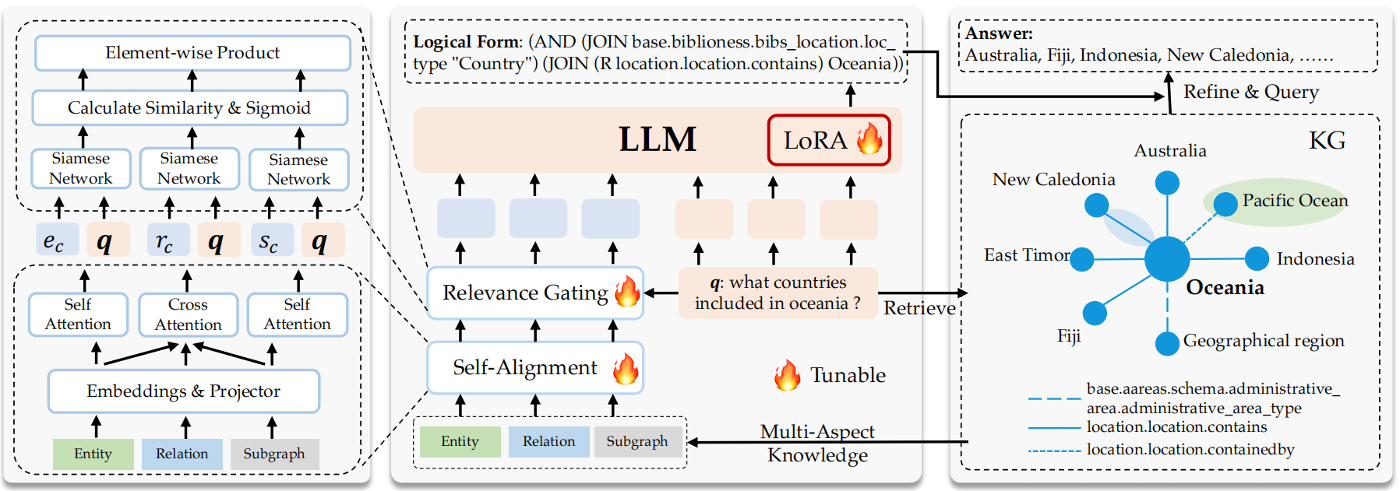
Overview

Slide 4
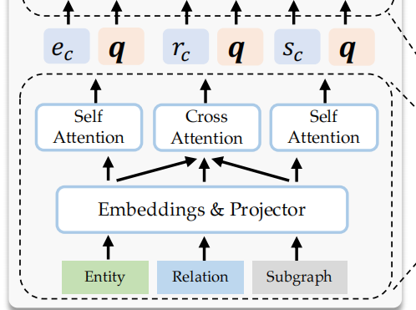
Approach

Slide 5
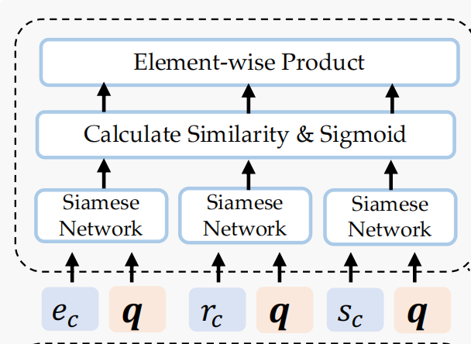
Approach

Slide 6
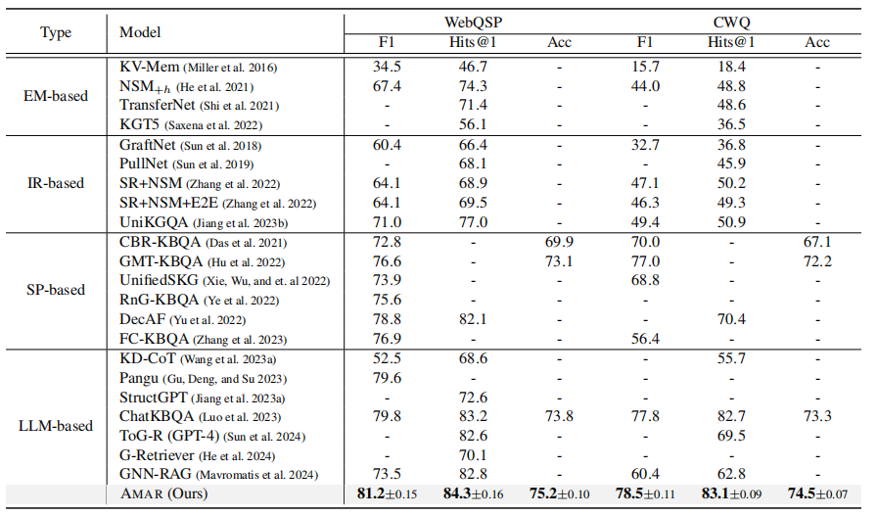
Experiment

Slide 7
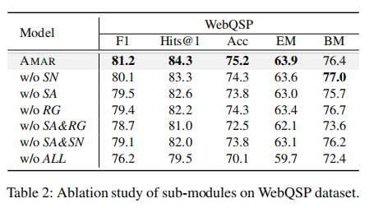
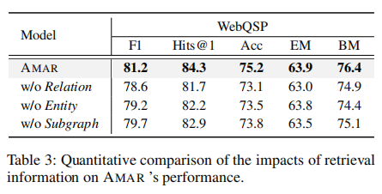
Experiment

Slide 8
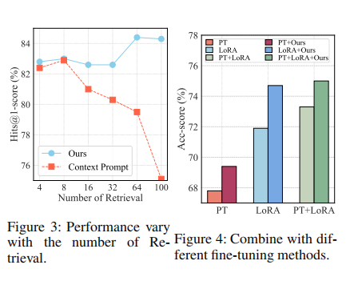
Experiment

Slide 9
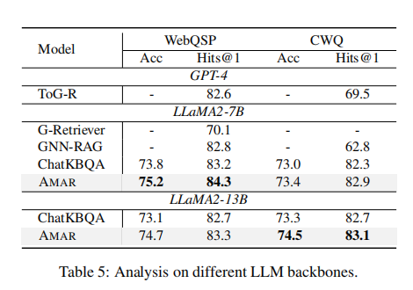
Experiment

Slide 10
Thank you!

